Slide 1
Serstech 100 Indicator
User manual version 6.1.X
© 2020 Serstech AB

Slide 2
Serstech 100 Indicator User Manual
Vers.6.1.X
Table of Contents
Introduction to the Serstech 100 Indicator .........................................................................4
Instrument safety ................................................................................................................4
Liability ................................................................................................................................ 4
Handling.............................................................................................................................. 4
Battery Operation and Charging ........................................................................................ 5
Intellectual Property Rights ................................................................................................ 5
Equipment Modifications ....................................................................................................5
Trademark Acknowledgments............................................................................................ 5
Support ............................................................................................................................... 6
Contact Information ............................................................................................................6
Invisible laser Safety Considerations .................................................................................6
Serstech 100 Indicator Peli case........................................................................................ 8
Accessories ........................................................................................................................ 8
Vial holder .........................................................................................................................10
Point and shoot adaptor ...................................................................................................11
Bottle adaptor ...................................................................................................................12
Angled probe tip................................................................................................................12
Calibration cap..................................................................................................................14
USB Cable ........................................................................................................................14
Indicator ............................................................................................................................15
Keypad..............................................................................................................................16
Log in ................................................................................................................................17
Main menu ........................................................................................................................18
Quick menu.......................................................................................................................20
Screen...............................................................................................................................21
Screen analysis result ......................................................................................................25
Screen review ...................................................................................................................27
Screen Settings ................................................................................................................28
Identify ..............................................................................................................................29
Identify analysis result ......................................................................................................33
Identify review...................................................................................................................34
Verify .................................................................................................................................35
Verify analysis result.........................................................................................................39
Verify review .....................................................................................................................40
Verify settings ...................................................................................................................41
Add substance ..................................................................................................................42
Add substance review ......................................................................................................46
Libraries ............................................................................................................................47
About.................................................................................................................................50
Time and Date ..................................................................................................................51

Slide 3
Serstech 100 Indicator User Manual Vers.6.1.X
Display properties.............................................................................................................52
Calibration control.............................................................................................................53
Calibration result...............................................................................................................55
Calibration settings ...........................................................................................................56
USB...................................................................................................................................58
Language..........................................................................................................................59
Factory Reset ...................................................................................................................60
Unpair Instrument .............................................................................................................62
Serstech 100 Indicator maintenance instructions ............................................................64
Standard method of cleaning (removing fat from the surfaces) ......................................65
Cleaning of excess dirt .....................................................................................................68
ChemDash ........................................................................................................................69
ChemDash ONE ...............................................................................................................70

Slide 4
Serstech 100 Indicator User Manual Vers.6.1.X
1. Introduction to the Serstech 100 Indicator
Raman spectroscopy is a spectroscopy technique which can be used for rapid identifications of chemicals. The Raman effect occurs when a light (e.g. from a laser) interacts with the sample molecules. Light scattered from the molecules gives rise to a spectrum that typically consists of a series sharp lines and constitutes molecules fingerprint.
The Serstech 100 Indicator is a hand-held Raman spectrometer which can be used without formal training in spectroscopy to obtain chemical identity of substances as well as verify the quality of known substances in order to be able to make immediate action decisions in the field. It also includes a function to screen for regulated substances. The Indicator is a standalone instrument that operates without need for other components. However, the instrument relies on access to libraries stored in the instrument and/ or ability to create and update these libraries externally. Basic computer knowledge is required for administrating the libraries and the users. Laser training is needed for all users since the instrument includes class 3B invisible laser.
This manual describes the basic functions of the Indicator as well as the connection to the software ChemDash ONE. Functions may be different depending on the hardware and/ or software version in the device. The manual covers Indicators with embedded software functionality version 5.3.0 or later.
The software version is shown in the “About” window. The serial number of the instrument is printed on the back of the instrument (S/N) and is also shown in the “About” window for software.
Please NOTE that you can access ChemDash ONE only if your instrument is running software version 4.0.1 or later. If your instrument is running an older version, please upgrade the firmware first by following the instructions in the Firmware Upgrade Guide on serstech.com
Instrument safety
This is intended for Laser Safety Officers, administrators and users of the SERSTECH Indicator handheld Raman spectrometer instrument. Please read through this section carefully before using the SERSTECH product. Keep the document for further reference.
Liability
Every care has been taken in the preparation of this document. Please inform your local reseller or SERSTECH AB of any inaccuracies or omissions. SERSTECH AB is not responsible for any technical or typographical errors and reserves the right to make changes to the product and manuals without prior notice. SERSTECH AB makes no warranty of any kind regarding the material contained within this document, including, but not limited to, the implied warranties of merchantability and fitness for a particular purpose. SERSTECH AB shall not be liable nor responsible for incidental or consequential damages in connection with the furnishing, performance or use of this material. This product is only to be used for its intended purpose.
Handling
For a safe handling Serstech AB recommends Users to do as following: Store the product in a dry and ventilated environment.

Slide 5
Serstech 100 Indicator User Manual Vers.6.1.X
Do not attempt to repair the product by yourself, contact SERSTECH or your SERSTECH reseller for service matters.
This product shall be used in compliance with local laws and regulations.
Always follow your organization’s procedure and regulations for the handling of unknown substances.
Always use small sample sizes to limit possible hazards.
Dark substances can sometimes absorb the energy from the laser and could possibly ignite, or, if the substance is explosive, it could be detonated. If you are in doubt, we recommend starting scanning with the laser power set to “Low” and use the “Start delay” function, so that you have time to safely move away from the sample before measurement is initiated.
The warranty is void if the product has been damaged by accident, unreasonable use, neglect or if the unit has been opened or tampered with or other causes not arising from defects in material or workmanship. This product is not designed to be intrinsically safe and the user should take the necessary precautions when using the unit.
The product is designed to be used in an everyday field environment and is therefore considerably more rugged than a laboratory unit. But it is important for the user to recognize that it is a precision instrument and should be treated with care. Abuse and mistreatment may lead to a degradation of performance or premature failure.
Battery Operation and Charging
The unit is specified for indoor and outdoor usage (-20°C to +40°C, 5 % to 90% relative humidity-RH). However, the Power Supply Unit (PSU) is designed for indoor use only and charging shall therefore always be performed indoors (0°C to +40°C, 8% to 90% relative humidity-RH).
Intellectual Property Rights
SERSTECH AB has intellectual property rights relating to technology embodied in the product described in this document. In particular, and without limitation, these intellectual property rights may include patents or pending patent applications in the US and other countries. This product contains third-party software.
Equipment Modifications
This equipment must be installed and used in strict accordance with the instructions given in the user documentation. This equipment contains no user-serviceable components. Unauthorized equipment changes or modifications will invalidate all applicable regulatory certifications and approvals
Trademark Acknowledgments
is a trademark of SERSTECH AB. All other company names and products are trademarks or registered trademarks of their respective companies. Ethernet, Internet Explorer, Linux, Microsoft, Mozilla, UNIX, Windows and WWW are registered trademarks of the respective holders. Java and all Java-based trademarks and logos are trademarks or registered trademarks of Oracle and/ or its affiliates. UPnP ™ is a certification mark of the UPnP ™ Implementers Corporation. SD, SDHC, SDXC, miniSD, microSD, miniSDHC, microSDHC and microSDXC are trademarks or registered trademarks of SD- 3C, LLC in the United States, other countries or both.

Slide 6
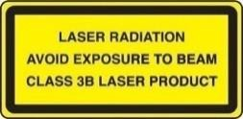
Serstech 100 Indicator User Manual Vers.6.1.X
Support
In case the User should requires technical assistance, should contact its SERSTECH reseller. If the User questions cannot be answered immediately, the reseller will forward all queries through the appropriate channels to ensure a rapid response.
Contact Information
The contact information of the company is as following:
SERSTECH AB
Ideon Science Park, Sölvegatan 43 SE-223 70 Lund, SWEDEN
e-mail: info@serstech.com
1.10 Invisible laser Safety Considerations
This operation manual includes information and warnings which must be observed by the user. It contains information NOTEs as well as information of importance to safety of personnel and property. The important symbols are:
 | This is a Class 3B laser product and complies with “Classified according to standard EN 60825-1:2014”. Class 3B requirements: A class 3B device shall have a warning signal, audible or visible when the invisible laser is active. A red LED in a yellow warning label placed adjacent to the display solves this requirement. According to the standard, there shall be a yellow label with a black border, the recommended wording is: WARNING – INVISIBLE LASER RADIATION AVOID EXPOSURE TO BEAM CLASS 3B LASER PRODUCT The backside label on the Serstech 100 Indicator solves this requirement. Also, the frontside label has the word WARNING according to standard requirements. Another requirement is that the laser aperture is labelled, there is thus a yellow pictogram label besides the nozzle. The only source for dangerous laser exposure is from the nozzle; the protective casing is designed not to leak laser emission in any other place. With intended use, there is no raised danger for laser exposure when accessing the display controls. A remote interlock connector is not required for handheld instruments. There are no service panels, viewing optics or scanning elements; requirements for these objects are thus not applicable. There shall be a mechanical attenuator/beam stop available to make it possible to block the beam from the nozzle temporarily. The stop is released with the instrument enclosed Calibration Unit, which also makes double duty as a dust cap. Class 3B is one of the most severe classes; meaning that it is easy to permanently harm the eye when the

Slide 7
Serstech 100 Indicator User Manual
Vers.6.1.X
 | product is not used properly. A class 3B product is not suited as a consumer product since the operator needs to be trained to use proper procedures to avoid eye damage. A safety interlock is needed to ensure that only trained operators use the instrument. A software requirement solves this; the operator needs to login with a PIN number to use the instrument. The software also turns the instrument off when inactive and a new login with PIN number is required. Ensure the beam is always terminated at a suitable non-specular (i.e. non-mirror- like) surface. Do not direct the beam at other people or into areas where other people unconnected with the laser work may be present. Refer to the International standard EN 60825-14 users’ guide for guidance on identifying and controlling hazards associated with laser use.
 | Always ensure the invisible laser is turned off when changing measuring accessories, e.g. from point-and- shoot adaptor to the vial holder.
 | WARNING: Exposure to levels of invisible laser energy above the MPE can be harmful to the eye. The minimum safety distance (Nominal Ocular Hazard Distance, NOHD) is 100 cm from the invisible laser aperture to avoid exposure to levels above the MPE. The output power is 300 mW at 785 nm. Always avoid exposure to the beam. Use administrative controls, engineering controls, and/ or laser safety glasses to avoid exposure to invisible laser radiation within the 100 cm hazard zone. Use invisible laser safety eyewear of an optical density (OD) greater than 3.
 | WARNING: Scanning a thermally sensitive material may cause burning of the target. If the sample is contained in a tightly sealed vessel (e.g. a capped vial), pressure may build up during the scan, causing subsequent explosion of the vessel.

Slide 8
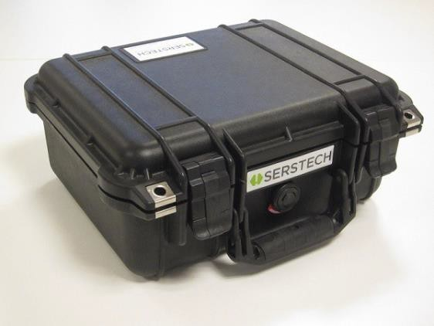
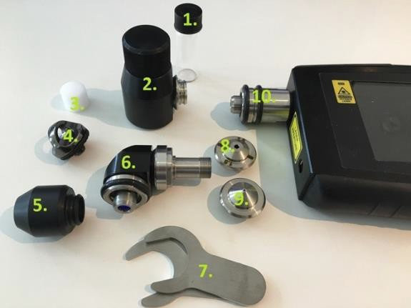
Serstech 100 Indicator User Manual Vers.6.1.X
2 Serstech 100 Indicator Peli case
The Serstech Indicator 100 instrument with the Accessories is delivered in a crush proof, dust proof and water resistant Peli case.
 | This is the Peli case.
3 Accessories
There are different accessories for different sample applications:
 | Sample vial Vial holder Vial holder insert Strap attachment Calibration cap Angled probe tip Mounting tools/wrenches Bottle adaptor Point and shoot adaptor Probe tip
So as to know what the most suitable accessory for your measurement is, please see the Table 1 and its explanation below:
Table 1: List of accessories according to their use
Sample substance | Sample holder | Holder wall thickness (mm) | Accessory: Probe tip together with | Laser point distance inside the sample (mm)
≥ 2.0 ml liquids | Standard vial | 1.3 | Vial holder | 0.1-0.9 (from the sample holder interior wall)
or powders
 | Bottles | 1.0-1.5 | Bottle adapter
 | Containers | 1.5-4.0 | -
≤ 2.0 ml liquids | Standard vial | 1.3 | Vial holder +
or powders |  |  | insert
Solids or powders | Plastic bags | - | Pont and shoot | 0.2
The purpose of the different adaptors is to keep the sample at the proper distance from the laser focus point. If the laser focus ends up too far inside the sample, the Raman signal

Slide 9
Serstech 100 Indicator User Manual Vers.6.1.X
will be attenuated and result to a low quality or unusable spectrum. On the other hand, e.g. if a container wall is thicker than 4 mm, the focus point will end up on the container wall and you will sample the container material instead of its content.
If the User measures through a glass or plastic container with 1.5-4.0 mm thick walls use probe tip (10. in the picture above) without any adaptor mounted. The laser focus will then be located 4.5-5.0 mm from the tip and therefore will end up inside the sample.
If the User measures through the standard sample vial with 14.8 mm outer diameter and
1.3 ±0.2 mm thickness, the laser will point 0.1-0.9 mm from the vial interior wall and 14 mm from the bottom of the vial inside the vial holder. Therefore, the vial must be filled up to 2 mL at least so that the laser focus ends up inside the sample and not in the air.
If the sample is less than 2 mL use the insert to raise up the vial inside the vial holder.
The laser focus will point 0.1-0.9 mm from the vial interior wall and 2 mm from the vial bottom. Minimum sample volume is approximately 0.4 mL.
With the point and shoot adaptor the focus will point approximately 0.2 mm from the adaptor tip. That's why the point and shoot adaptor is appropriate to use when measuring though a thin plastic bags or flush to a solid surface of the sample.
If the container has 1.0-1.5 mm thick walls use the bottle adaptor.
NOTE: It is very important to reduce stray light from entering the instrument as much as possible, e.g. by covering the container with a black cloth unless the User uses the vial holder adaptor. It is also recommended to use the auto-exposure mode. The amber glass vessels and fogged plastic material will reduce the quality of the signal and thus the obtained spectrum. The signal quality may be also reduced for the opaque samples, e.g. powders because of the sample depth (affected by factors as the grain size), fluorescence, sample actual Raman response etc. However, for transparent, non- fluorescent liquid samples there are a much wider margin.

Slide 10
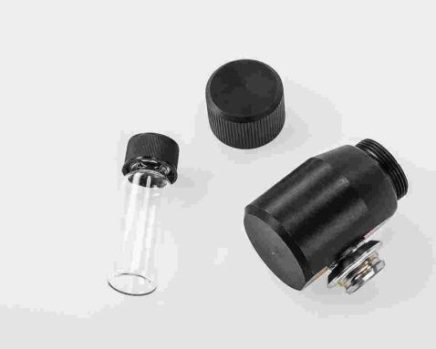
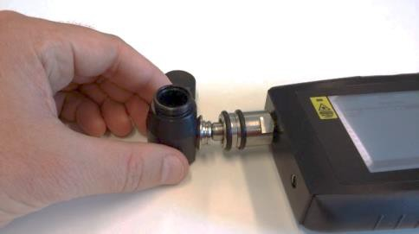
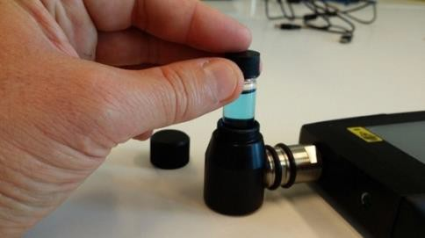
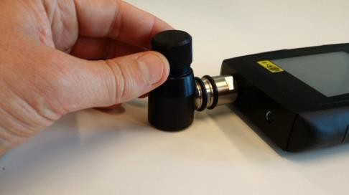
Serstech 100 Indicator User Manual Vers.6.1.X
Vial holder
The vial holder isused foranalysis ofliquid samples in vials. One sample vial is shipped with the instrument. Generally, the vial holder can be used with both probe tip and angled probe tip. In this example we will use it with the straight probe tib.
 | The holder accepts 4 mL standard vials with 14.8 mm outer diameter and 1.3 (±0.2) mm thickness.
 | To mount the vial holder simply snapit to the probe tip.
 | Add the sample into the vial.
 | WARNING: Scanning a thermally sensitive material may cause burning of the target. If the sample is contained in a tightly sealed vessel (e.g. a capped vial), pressure may build up during the scan, causing subsequent explosion of the vial.
 | Place the vial into the vial holder.
 | Screw the cap on and start the measurement.

Slide 11
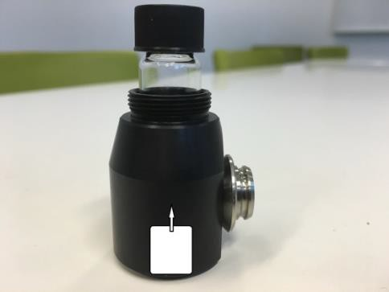
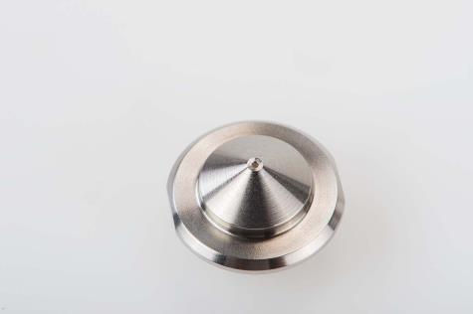
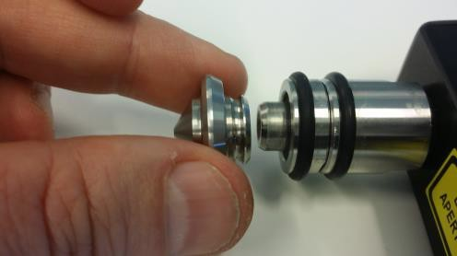
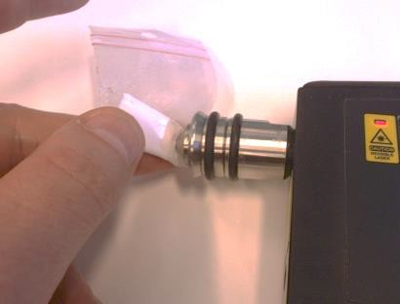
Serstech 100 Indicator User Manual
Vers.6.1.X
 | Vial holder inserter The insert serves as a support for the vials filled with a sample up to 0.4 mL.
2.2 Point and shoot adaptor
The point and shoot adaptor have a conical shape for easy measurement of any size and shape of samples. This will ensure optimal versatility and measurement results. Generally, the point and shoot adaptor can be used with both straight probe tip and angled probe tip.
 | To attach the point and shoot adaptor please follow the steps bellow:
 | Align bezels of adaptor to corresponding notches on the probe tip Align the adaptor into position Slightly pull and rotate when removing the adaptor
 | With the point and shoot adaptor the measurements can be made e.g. through transparent plastic bags by gently pressing the adaptor against the bag. NOTE: The laser focus is typically under 20μm (0.02 mm)
 | WARNING: Keep the sample pressed against the adaptor until the red diode, indicating invisible laser activity, is turned off.

Slide 12
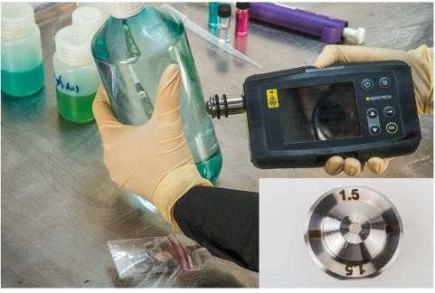
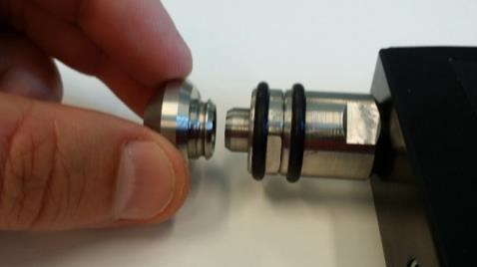
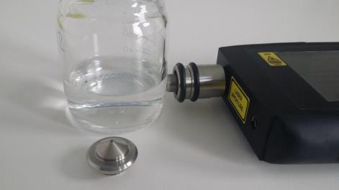
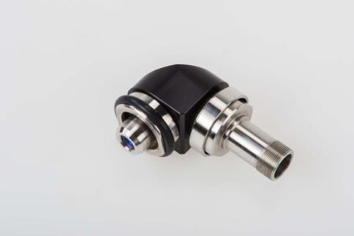
Serstech 100 Indicator User Manual
3.3 Bottle adaptor
Vers.6.1.X
The bottle adaptor looks similar to the point and shoot adaptor and is used when measuring through a transparent container with a thickness of 1.0 -1.5 mm. Generally, the bottle adaptor can be used with both probe tip and the angled probe tip. In this example we will use it with the straight probe tip.
 | To attach the bottle adaptor please follow the steps bellow:
 | Align bezels of adaptor to corresponding notches on probe tip Align the adaptor into position Slightly pull and rotate when removing the adaptor
 | Measure without an adaptor if your container is 1.5- 4.0 mm thick. Place the container flush to the instrument probe tip and start the measurement.
3.4 Angled probe tip
The angled probe tip is used for analysis of solid samples. It can be used for measurements of e.g. powders through a plastic bag when sampling potentially explosive substances.
 | The angled probe tip.

Slide 13
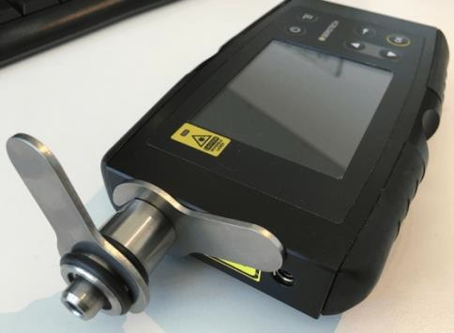
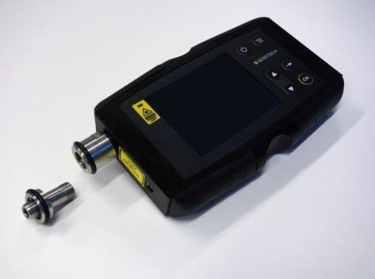
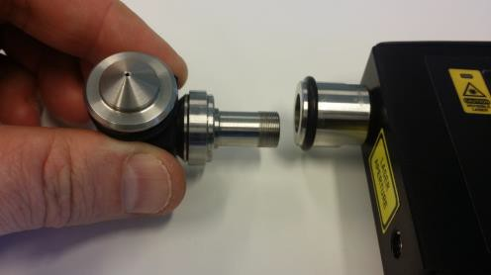
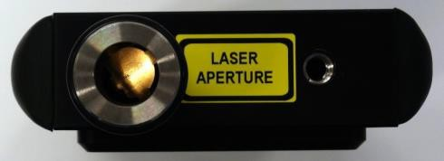
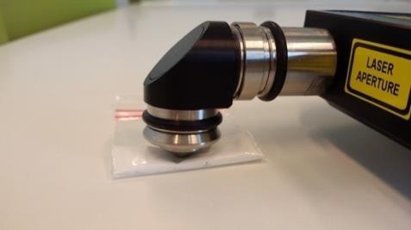
Serstech 100 Indicator User Manual
Vers.6.1.X
 | WARNING: Before mounting the angled probe tip make sure that the Indicator is turned off. Exposure to the beam can result in serious eye damage!
 | To mount the angled probe tip first remove the current probe tip from the instrument. Use two specially designed wrenches supplied with the instrument. Place one wrench in the notch on the probe tip next to the instruments main body and the other in the similar notch between the two rubber rings.
 | Hold the wrench next to the instruments main body still and turn the wrench on the probe tip counterclockwise to remove it.
 | Attach the angled probe tip by gently inserting the threaded part and screw it in place by hand. Use the wrenches to tighten. Make sure that the tip is securely fastened, but do not overtighten. The angled probe tip accepts the point and shoot adaptor, the bottle adaptor, the vial holder and the calibration cap.
 | NOTE: Make sure not to damage the invisible laser shutter when mounting the angled probe tip. The invisible laser shutter prevents any accidental exposure to the collimated laser beam.
 | Put the instrument on a flat surface with the adaptor in contact with the sample and start the measurement. Since it will take some time before the invisible laser is turned on the operator can move away from the instrument to a safe area.

Slide 14
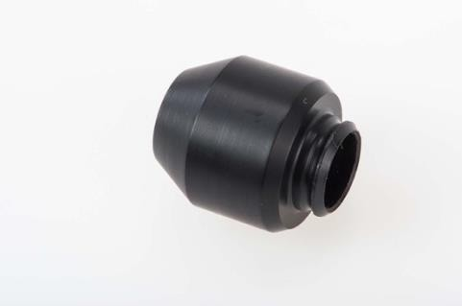
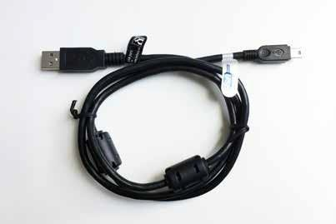
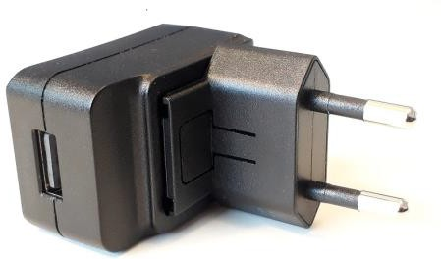
Serstech 100 Indicator User Manual
Vers.6.1.X
3.5 Calibration cap
 | The calibration cap contains a polystyrene target and is used for the calibration control of the instrument. It is also protecting the optics inside the probe tip.
3.6 USB Cable
 | The supplied USB cable is the connection cable between the Indicator and a PC, used to access ChemDash ONE.
 | The USB cable is also used to connect the optional USB charger to the Indicator.

Slide 15
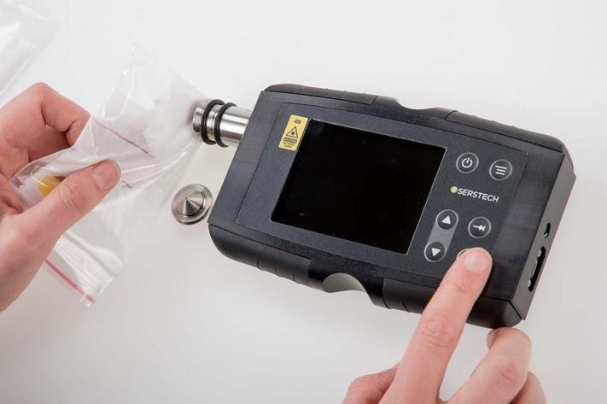
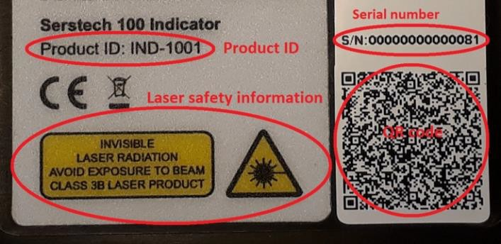
Serstech 100 Indicator User Manual
Vers.6.1.X
3 Indicator
All the Indicator functions are controlled through the Keypad.
 | On the front side of the Indicator there is a clearly visible laser warning label with a red indicator LED that is lit when the invisible laser is operating.
 | On the backside of the instrument it can be found: Product ID Invisible laser safety information Serial number QR code
 | Important NOTE: Analysis of strongly reflecting samples, e. g. mirrors, must be avoided since this can harm the instrument and void the warranty.

Slide 16
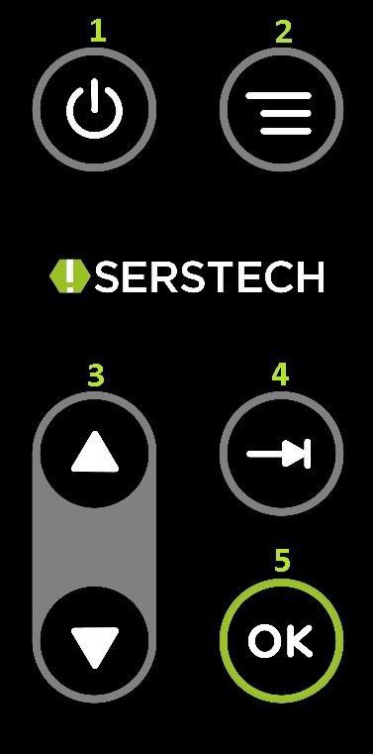
Serstech 100 Indicator User Manual Vers.6.1.X
NOTE: Be aware of that any measurement is sensitive to stray light entering the instrument through the probe tip. Stray light will not damage the instrument but may cause corruption of the measurement. Daylight usually contains a substantial amount of near infrared radiation in the same spectral range as the Raman bands, making it difficult to filter out without simultaneously reducing instrument detection sensitivity. When doing a scan outside in bright sunlight, it is recommended to scan the sample using the capped vial holder, if possible. When scanning solid materials, e.g. in plastic bags, you should limit the amount of stray light as much as possible, e.g. by doing the measurements in a shaded area and cover the front lens aperture.Also, please note that dark substances can sometimes absorb the energy from the laser and could possibly ignite, or, if the substance is explosive, it could be detonated. If you are in doubt, we recommend starting scanning with the laser power set to “Low” and use the “Start delay” function, so that you have time to safely move away from the sample before measurement is initiated.
3.1 Keypad
 | Power Start the instrument by pressing the power button and shut it down by keeping the power button pressed for 5 seconds. Quick Menu button Back- Returns to the previous menu Home- Main menu USB- USB Calibrate-Calibration Settings-Main menu Settings Arrows Use the up and down arrow buttons to move between the different items in the menus. Arrows Use the tab button to move between the different fields in the menus. OK button Execute choices by pressing the OK button.

Slide 17
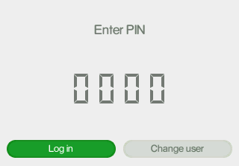
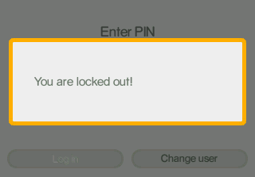
Serstech 100 Indicator User Manual Vers.6.1.X
3.2 Log in
In order to log in the Serstech 100 Indicator, please follow all steps described below:
 | Start the instrument by pressing the button Select your identity from the list in the window: If the instrument is started for the first time, there are two predefined users that may be used to access the instrument: Default, Admin Default, User Scroll with the arrow keys between the alternatives. Press the OK button to select a user Enter your four-digit personal code that your local Indicator administrator has supplied you with. Move between the four different digits with the [Tab] key. Use the up and down arrows to change the value for each of the four digits. The value can be set to 0-9. Press the OK button. The Main menu will be displayed after a successful log-in. After 3 unsuccessful attempts typing the wrong PIN code, the User will automatically be locked out. To change the PIN code please contact our Support. NOTE: When the instrument is started for the first time the PIN code (supplied with the instrument) is 0000. It is up to the User to change its PIN code on the device through ChemDash ONE.

Slide 18
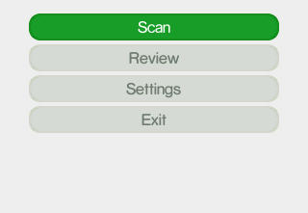
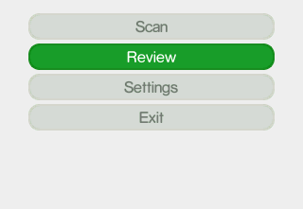
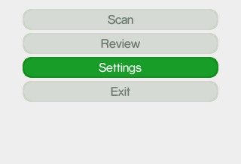
Serstech 100 Indicator User Manual Vers.6.1.X
3.3 Main menu
Features of the Main menu are Scan, Review, Settings and Exit. You can quick access the Main menu by using the Quick Menu button and select Home.
 | Select Scan if you want to: Screen to search a substance(s) Identify an unknown substance(s) Verify a known substance(s) Add new substance (s) Scan settings: Screen Settings Verify Settings Calibration Settings
 | Select Review if you want to see the history of your measurements: Screen Review Identify Review Verify Review Add substance Review Back to the Main menu
 | Select Settings to access the options: About Time and Date Display properties Administration: Calibrate USB Language Factory Reset Back to the Main menu

Slide 19
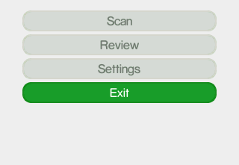
Serstech 100 Indicator User Manual
Vers.6.1.X
 | Select Exit if you want to: Log of from the Indicator Restart the Indicator Shut down the Indicator Back to the Main menu

Slide 20
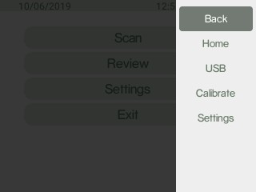
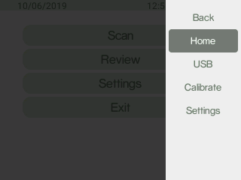
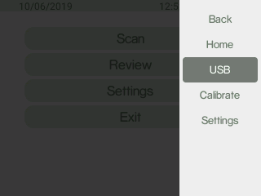
Serstech 100 Indicator User Manual
Vers.6.1.X
3.4 Quick menu
The Quick Menu is opened when the Quick Menu button is pressed. Features of the Quick menu are Back, Home, USB, Calibrate and Settings.
Use the up and down arrows to move between the different menu items. The Quick menu is closed by pressing the Quick Menu button.
 | Select Back to return to the previous menu.
 | Select Home to go to the Main menu.
 | Select USB to activate the USB port.

Slide 21
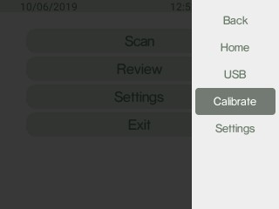
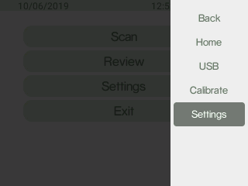
Serstech 100 Indicator User Manual
Vers.6.1.X
 | Select Calibrate to go to Calibration.
 | Select Settings to go to Main menu Settings.
4 Screen
This method is used for screening a list of restricted chemicals for the presence of a regulated substance(s) in the sample, e.g. narcotics and explosives.
Narcotics and explosives are two screen categories of the instrument. Each substance of these two categories has its "Regulatory Type" settings in the reference library depending on the severity. The regulatory types are listed under Screen analysis result:
Select the appropriate accessory for the analysis
Log in to the Indicator
Select the category of substances you want to screen i.e. narcotics, explosives or both under Screen Settings.

Slide 22
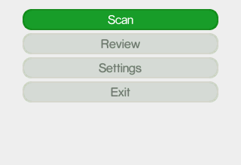
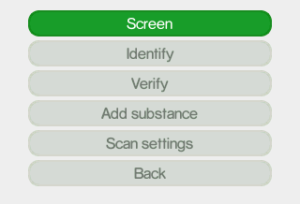
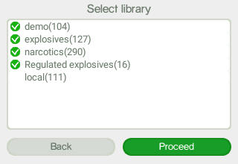
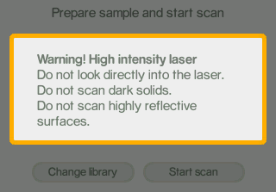
Serstech 100 Indicator User Manual
Vers.6.1.X
 | Select Scan from the Main menu.
 | Select Screen.
 | Select one or several libraries you will use for the analysis: Demo (amount of substances) library comes with the instrument. You can build your own personalized local (amount of substances) library with the Add Substance method.
 | A laser warning pop-up message is given before the preparation can be finished and the scan started. Press OK to proceed.

Slide 23
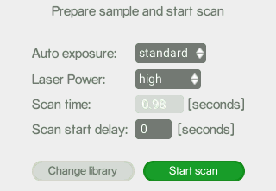
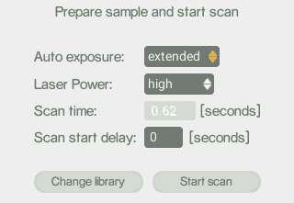
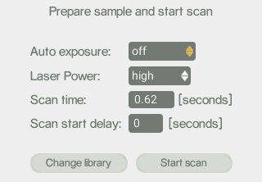
Serstech 100 Indicator User Manual
Vers.6.1.X
 | How to set the exposure parameters: The Auto exposure mode can be set to the values standard, extended or off with the up and down arrows. NOTE: To obtain best spectral quality the Auto exposure modes standard or extended should be used. The invisible laser power can be set to the values low, medium or high with the up and down arrows. The output power is 300 mW at 785 nm. The Scan start delay; delays the start of the of the invisible laser. Use Scan start delay whenever there is any risk that the substance to be analyzed can burn or explode. The Scan start delay can be set for 0-999 seconds with , giving the user time to move away from the instrument before the invisible laser is activated. Start scan by pressing OK.
 | NOTE: Auto exposure mode set to extended. In extended mode the indicator makes additional exposures to improve the signal quality. The signal improvement may take some time.
 | NOTE: If Auto exposure is off the Scan time must be set. Set the Scan time with the up & down arrow keys.
NOTE: In Auto-exposure standard and extended mode the Indicator will analyze the sample and try to calculate the ideal exposure time needed to get optimal signal-to-noise ratio in the measured spectrum, i.e. maximize the quality of the spectrum. The calculated exposure can be in the range of 0.02 – 32 seconds, depending on compound and sampling conditions. In extended mode additional exposures will be made to improve the signal

Slide 24
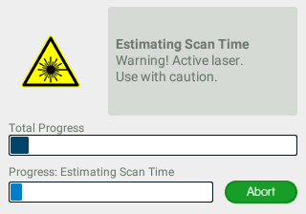
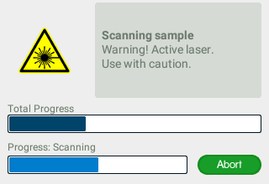
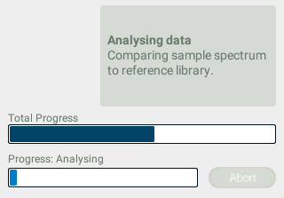
Serstech 100 Indicator User Manual Vers.6.1.X
quality. When using these modes, the total process time will be from 3 seconds longer compared to manual mode since several trial exposures and signal improvement will be made in addition to the final measurement. The total accumulated invisible laser exposure on the sample will also increase compared to manual exposure mode. Until the actual analysis starts there is always the option to abort the measurement.
Follow the different steps in the sample analysis:
 | Estimating Scan Time: The ideal exposure time is calculated. The upper progress bar shows the progress of the total scan process. The lower progress bar shows the progress of the current part of the scan process. The scan can be aborted by pressing OK. You will return to the previous menu.
 | Scanning sample: Collecting Raman spectrum. If Auto exposure extended mode is used the signal improvement may take some time. The scan can be aborted by pressing OK. You will return to the previous menu.
 | Analyzing: Analyzing Raman spectrum and compare to the chosen library. The scan can no longer be aborted.

Slide 25
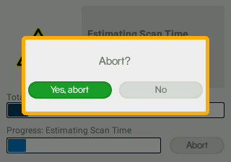
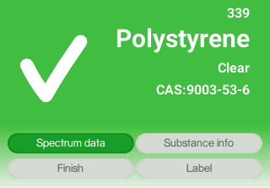
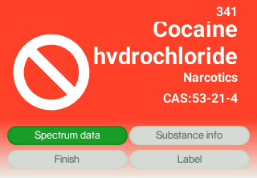
Serstech 100 Indicator User Manual
Vers.6.1.X
 | If the scan is aborted a pop-up dialogue window is displayed where the user has to confirm the abortion. Aborting scan: a pop-up dialogue window is displayed Confirm the abortion by pressing OK. You will return to the previous menu
4.1 Screen analysis result
These are the possible outcomes of the Screen scan in the Screen category used for measurements:
 | Clear: The substance found is classified as not regulated. Sequential number in the upper right corner, here the number 339, is the number of measurements done with the instrument.
 | Regulated substance: The substance found is classified as a regulated substance e.g. a narcotic or explosive substance that is listed as illegal.

Slide 26
Serstech 100 Indicator User Manual
Vers.6.1.X
 | Not yet Categorized: The substance found comes from the local library is classified as not yet been categorized. You can categorize the substance from ChemDash.
 | Select Label to label the measurement. In case you want to write either a note or a name or CAS number to the analyzed substance you can click on Label and select characters. Once you are done, please click on Save.
 | Inconclusive Result: There is no spectrum in the libraries that matches the sample spectrum. You may want to re-test the sample while paying close attention to that the sample is correctly positioned at the instruments focal point and the instrument is not exposed to strong ambient light.

Slide 27
Serstech 100 Indicator User Manual Vers.6.1.X
4.2 Screen review
The Review function allows you to examine the history of the measurements made with the instrument.
 | Select Review from the Main menu.
 | Select Screen.
 | Choose the specific measurement you want to review. The measurements are named [sequential number] year-month-day- hour-minute- seconds. Scroll using the arrow key in the Select result window. Highlight the View button with the tab key and press OK. See Screen analysis result for this specific measurement.

Slide 28
Serstech 100 Indicator User Manual Vers.6.1.X
4.3 Screen Settings
Here you can select the Screen category that you want to use for your measurement.
 | Select Scan from the Main menu.
 | Select Scan settings.
 | Select Settings screen.
 | Select the category you want and click Save.

Slide 29
Serstech 100 Indicator User Manual
Vers.6.1.X
5 Identify
The Identify method is used to identify an unknown substance in a sample. The Indicator matches the unknown chemical to the chosen library. All substances that match the sample will be listed and you can access specific substance (chemical safety) information for all matches found.
This is not category matching like that used in the Screen method described above.
The analysis is based on molecular spectral data only, regardless the category.
 | Select Scan from the Main menu.
 | Select Identify.
 | Select one or several libraries you will use for the analysis.

Slide 30
Serstech 100 Indicator User Manual
Vers.6.1.X
 | Select the appropriate accessory for the analysis. Log in to the Indicator An invisible laser warning pop-up message is given before the preparation can be finished and the scan started. Press OK to proceed
 | Set exposure parameters: The Auto exposure mode can be set to the values standard, extended or off. NOTE: To obtain best spectral quality the Auto exposure modes standard or extended should be used The invisible laser power can be set to the values low, medium or high. The Scan start delay delays the start of the scan and thus the activation of the invisible laser. Use Scan start delay whenever.
 | There is any risk that the substance to be analyzed can burn or explode. The Scan start delay can be set for 0-999 seconds giving the user time to move away from the instrument before the invisible laser is activated. Start scan by pressing OK. Auto exposure mode set to extended. In extended mode the indicator makes additional exposures to improve the signal quality. The signal improvement may take some time.

Slide 31
Serstech 100 Indicator User Manual
Vers.6.1.X
 | If Auto exposure is OFF the Scan time must be set. NOTE: In Auto-exposure standard and extended mode the Indicator will analyze the sample and try to calculate the ideal exposure time needed to get optimal signal-to-noise ratio in the measured spectrum, i.e. maximize the quality of the spectrum. The calculated exposure can be in the range of 0.02 – 32 seconds, depending on compound and sampling conditions. In extended mode additional exposures will be made to improve the signal quality. When using these modes, the total process time will be from 3 seconds longer compared to manual mode since several trial exposures and signal improvement will be made in addition to the final measurement. The total accumulated invisible laser exposure on the sample will also increase compared to manual exposure mode. Until the actual analysis starts there is always the option to abort the measurement.

Slide 32
Serstech 100 Indicator User Manual
Vers.6.1.X
Follow the different steps in the sample analysis:
 | Estimating Scan Time: The ideal exposure time is calculated. The upper progress bar shows the progress of the total scan process. The lower progress bar shows the progress of the current part of the scan process. The scan can be aborted by pressing OK. You will return to the previous menu.
 | Scanning sample: Collecting Raman spectrum If Auto exposure extended mode is used the signal improvement may take some time. The scan can be aborted by pressing OK. You will return to the previous menu.
 | Analyzing: Analyzing Raman spectrum and compare to the chosen library. The scan can no longer be aborted.
 | If the scan is aborted a pop-up dialogue window is displayed where the user has to confirm the abortion. Aborting scan: a pop-up dialogue window is displayed. Confirm the abortion by pressing OK. You will return to the previous menu.

Slide 33
Serstech 100 Indicator User Manual
Vers.6.1.X
5.1 Identify analysis result
There are three possible outcomes from the Identify scan:
 | One single match found: A match between the sample spectrum and a single reference spectrum in the library has been found. The numerical value given in conjunction to the substance name, here 99.0%, is a score factor describing how well the reference spectrum describes the sample. Thus, a high number indicates that it is very likely that the sample contains the suggested substance. Sequential number in the upper right corner, here 344, is the number of measurements done with the instrument.
 | Possible mixture 92.0% of spectrum explained: The obtained spectrum cannot be explained by one single library reference but by a mixture of library items. Here Isopropanol is the library reference that has the best correlation with the sample spectrum and thus presented on the top of the list. Three listed library references together explain the sample spectrum to 92.0% and the mixture thus has a score factor of 92.0%. Sequential number in the upper right corner, here 345, is the number of measurements done with the instrument.
 | No match: This result can indicate that the measured spectrum is of sufficient quality for analysis but any correlation with spectra in the active libraries is too low. NOTE: No match result may also be due to too low spectrum signal to noise ratio if the data quality is too bad for meaningful analysis. In this case no processed spectrum is stored in the instrument. It is possible to go back and review the spectrum later.

Slide 34
Serstech 100 Indicator User Manual
Vers.6.1.X
 | Select Label to label the measurement. In case you want to write either a note or a name or CAS number to the analyzed substance you can click on Label and select characters. Once you are done, please click on Save.
5.2 Identify review
The Review function allows you to examine the history of your measurements made with the instrument.
 | Select Review from the Main menu.
 | Select Identify.

Slide 35
Serstech 100 Indicator User Manual
Vers.6.1.X
 | Choose the specific measurement you want to review. The measurements are named [sequential number] year-month-day-hour- minute-seconds Scroll using in the Select result window. Highlight the View button with and press OK.
6 Verify
Verify method is similar to the Screen in the sense that you know what you are searching for, but in case with Verify you only search for a match to one specific substance rather than several. Verify is used when you want to confirm that the sample is of the correct identity.
Before the measurement you will choose a reference substance from the spectra libraries. The Indicator will analyze the sample and compare it with the chosen reference.
The result is binary, either Pass (OK) if the sample is similar to the reference spectrum or Fail (not OK) if the sample is different.
 | Select Scan from the Main menu. Select the appropriate accessory for the analysis.
 | Select Verify.

Slide 36
Serstech 100 Indicator User Manual
Vers.6.1.X
 | Select one or several libraries you will use for the analysis.
 | Select the substance you want to verify. If you have many reference substances it may be useful to sort the list. This is done with the labels at the top of the window. By selecting a suitable label, you can sort the list on numbers or alphabetically. Highlight the appropriate substance and the press OK. NOTE: if substances have names with non-ASCII characters these substances will all appear under the label ALL.
 | An invisible laser warning pop-up message is given before the preparation can be finished and the scan started. Press OK to proceed.
 | Set exposure parameters. The Auto exposure mode can be set to the values standard, extended or off with. NOTE: To obtain best spectral quality the Auto exposure-standard or extended modes should be used. The invisible Laser power can be set to the values low, medium or high with. The Scan start delay delays the start of the scan and thus the activation of the invisible laser. Use Scan start delay whenever

Slide 37
Serstech 100 Indicator User Manual
Vers.6.1.X
 | there is any risk that the substance to be analyzed can burn or explode. The Scan start delay can be set for 0-999 seconds with, giving the user time to move away from the instrument before the invisible laser is activated. Start scan by pressing OK.
 | Auto exposure mode set to extended. In extended mode the indicator makes additional exposures to improve the signal quality. The signal improvement may take some time.
 | If Auto exposure is OFF the Scan time must be set.
NOTE: In Auto-exposure standard and extended mode the Indicator will analyze the sample and try to calculate the ideal exposure time needed to get optimal signal-to-noise ratio in the measured spectrum, i.e. maximize the quality of the spectrum. The calculated exposure can be in the range of 0.02 – 32 seconds, depending on compound and sampling conditions. In extended mode additional exposures will be made to improve the signal quality. When using these modes, the total process time will be from 3 seconds longer compared to manual mode since several trial exposures and signal improvement will be made in addition to the final measurement. The total accumulated invisible laser exposure on the sample will also increase compared to manual exposure mode. Until the actual analysis starts there is always the option to abort the measurement.

Slide 38
Serstech 100 Indicator User Manual
Vers.6.1.X
Follow the different steps in the sample analysis:
 | Estimating Scan Time: The ideal exposure time is calculated. The upper progress bar shows the progress of the total scan process. The lower progress bar shows the progress of the current part of the scan process. The scan can be aborted by pressing OK. You will return to the previous menu.
 | Scanning sample: Collecting Ramanspectrum If Auto exposure extended mode is used the signal improvement may take some time. The scan can be aborted by pressing OK You will return to the previous menu.
 | Analyzing: Analyzing Raman spectrum and compare to the chosen libraries. The scan can no longer be aborted.
 | If the scan is aborted a pop-up dialogue window is displayed where the user has to confirm the abortion. Aborting scan: a pop-up dialogue window is displayed. Confirm the abortion by pressing OK. You will return to the previous menu.

Slide 39
Serstech 100 Indicator User Manual
Vers.6.1.X
6.1 Verify analysis result
There are two possible outcomes from the Verify scan, either Pass (OK) if the sample is like the reference spectrum or Fail (not OK) if the sample is different.
 | Pass screen is displayed if the analyzed substance spectrum has sufficient correlation with the reference spectrum, i.e. equal to or over the Verify Threshold limit. The sequential number in the upper right corner, here 349, is the number of measurements done with the instrument.
 | Fail screen is displayed if the analyzed substance spectrum has a correlation with the reference spectrum which is below the Verify Threshold limit. The sequential number in the upper right corner, here 348, is the number of measurements done with the instrument.
 | Select Label to label the measurement. In case you want to write either a note or a name or CAS number to the analyzed substance you can click on Label and select characters. Once you are done, please click on Save.

Slide 40
Serstech 100 Indicator User Manual Vers.6.1.X
6.2 Verify review
The Review function allows you to examine the history of your measurements made with the instrument.
 | Select Review from the Main menu.
 | Select Verify.
 | Choose the specific measurement you want to review. The measurements are named [sequential number] year-month- day-hour-minute-seconds. Scroll using in the Select result window. Highlight the View button with and press OK.

Slide 41
Serstech 100 Indicator User Manual
Vers.6.1.X
6.3 Verify settings
 | Select Scan from the Main menu.
 | Select Scan settings.
 | Select Verify. Select Settings Verify.
 | Set the Verify Threshold parameter. The default value is 80% which means that there must be 80% or higher correlation between the sample spectrum and reference spectrum in order to indicate a Pass result. Expert users may modify this to suit a particular application, but we strongly recommend that it is left unchanged. Use to move between the options.

Slide 42
Serstech 100 Indicator User Manual
Vers.6.1.X
Use to change the values.
Press OK to Save.
7 Add substance
With the Indicator you can create your own library and use your own substances as a reference. All new substances will be stored in the library called "local".
 | Select Scan from the Main menu.
 | Select Add substance.
 | An invisible laser warning pop-up message is given before the preparation can be finished and the scan started. Press OK to proceed.

Slide 43
Serstech 100 Indicator User Manual
Vers.6.1.X
 | Set exposure parameters. The Auto exposure mode can be set to the values standard or off with. NOTE: To obtain best spectral quality the Auto exposure mode standard should be used. The Laser power can be set to the values low, medium or high with. Use Scan start delay whenever there is any risk that the substance to be analyzed can burn or explode. The Scan start delay can be set for 0-999 seconds with, giving the user time to move away from the instrument before the invisible laser is activated. Start scan by pressing OK
 | If Auto exposure is OFF the Scan time must be set. Set number of scan repeats to create the reference spectrum.
NOTE: In Auto-exposure standard mode the Indicator will analyze the sample and try to calculate the ideal exposure time needed to get optimal signal-to-noise ratio in the measured spectrum, i.e. maximize the quality of the spectrum. The calculated exposure can be in the range of 0.02 – 32 seconds, depending on compound and sampling conditions. When using this mode, the total process time will be from 3 seconds longer compared to manual mode since several trial exposures and signal improvement will be made in addition to the final measurement. The total accumulated invisible laser exposure on the sample will also increase compared to manual exposure mode. Until the actual analysis starts there is always the option to abort the measurement.

Slide 44
Serstech 100 Indicator User Manual
Vers.6.1.X
Follow the different steps in the sample analysis:
 | Estimating Scan Time: The ideal exposure time is calculated. The upper progress bar shows the progress of the total scan process. The lower progress bar shows the progress of the current part of the scan process. The scan can be aborted by pressing OK. You will return to the previous menu.
 | Scanning sample: Collecting Raman spectrum. Current repeat is shown above the lower progress bar. The sample is scanned the number of repeats set. The scan can be aborted by pressing OK. You will return to the previous menu.
 | Analyzing data: Analyzing and processing Raman spectra into a reference spectrum. The scan can no longer be aborted.
 | The Spectrum data of the measured spectra are viewed. Select Add to store the new substance in the local library. Elect Discard to discard the measurement. Select Label to label the measurement.

Slide 45
Serstech 100 Indicator User Manual
Vers.6.1.X
 | In case you want to write either a note or a name or CAS number to the analyzed substance you can click on Label and select characters. Once you are done, please click on Save.
 | The notes you added will be displayed in the Indicator as well as in ChemDash on the section Measurement Notes.
 | In case you select Add, confirm your choice to add the substance with a certain entry number. The entry number is based on the scan sequence number, here A-344. The substance can be edited later from ChemDash. A pop-up message confirms that the substance has been added to the local library. Press OK to proceed.
If you do not want to add the sample to the local library:
 | Select Discard if you do NOT want to store the new substance in the local library. Confirm your choice to discard the substance.

Slide 46
Serstech 100 Indicator User Manual
Vers.6.1.X
 | If the scan is aborted a pop-up dialogue window is displayed where the user must confirm the abortion. Aborting scan: a pop-up dialogue window is displayed. Confirm the abortion by pressing OK. You will return to the previous menu.
7.1 Add substance review
The Review function allows you to examine the history of measurements made with the instrument.
 | Select Review from the Main menu.
 | Select Add substance.

Slide 47
Serstech 100 Indicator User Manual
Vers.6.1.X
 | Choose the specific measurement you want to review. The measurements are named [sequential number] year-month-day- hour-minute-seconds. Scroll using in the Select result window. Highlight the View button with and press OK to view the spectrum.
8 Libraries
The Review Libraries function allows you to examine the libraries on the instrument.
 | Select Review from the Main menu.
 | Select Libraries.

Slide 48
Serstech 100 Indicator User Manual
Vers.6.1.X
 | Choose the specific library you want to review. The number within brackets after the name is the amount of substances in the library. Scroll using in the Select library window. Use to highlight the Back button. Select library by pressing OK.
 | The View button is automatically highlighted when a library has been selected. Press OK to view the library.
 | All the substances in the library are listed. If you have many reference substances it may be useful to sort the list. This is done with the labels at the top of the window. By selecting a suitable label, you can sort the list on numbers or alphabetically. Highlight the appropriate pressing OK. NOTE: if substances have names with non-ASCII characters these substances will all appear under the label ALL.

Slide 49
Serstech 100 Indicator User Manual
Vers.6.1.X
In the Review Libraries, screen the local library can be deleted.
 | Select the local library. Highlight the Delete button with and press OK.
 | A warning pop-up message is given where the user has to confirm the wish to delete the library. It is not possible to restore the local library once it has been deleted. Press OK to accept.
 | The local library has now been deleted from the instrument.

Slide 50
Serstech 100 Indicator User Manual
Vers.6.1.X
9 About
In the About screen the Indicator settings for firmware and hardware are displayed.
 | Select Settings in the Main menu.
 | Select About.
 | The Indicator settings for firmware and hardware are displayed. Scroll using to view the information on the instrument serial number, software and microcontroller firmware version, memory usage, temperature sensor readings etc. This information cannot be edited by the user.

Slide 51
Serstech 100 Indicator User Manual
Vers.6.1.X
10 Time and Date
In the Time and date screen the Indicator time and date can be set.
 | Select Settings from the Main menu
 | Select Time and Date.
 | The time, date and time zone are displayed.

Slide 52
Serstech 100 Indicator User Manual
Vers.6.1.X
11 Display properties
 | Select Settings from the Main menu.
 | Select Display properties.
 | The Display properties can be changed to conserve battery time. Screen save delay will turn off the display after 5 min after the dimming. Shutdown delay will shut down the Indicator after 60 min of inactivity. Display brightness with 50% will enter the dimmed brightness with 30% after 60 sec of inactivity. NOTE: The display brightness settings strongly impact the battery life. It is recommended to use as low settings as possible for default and dimmed brightness to maximize battery life. It is also recommended to use as short shutdown delay time as possible for the same reason.

Slide 53
Serstech 100 Indicator User Manual
Vers.6.1.X
12 Calibration control
To ensure the performance of the instrument it should be checked its calibration regularly, e.g. daily check. To pass the calibration stage, the measured spectrum must correspond to 90% the reference spectrum of calibration substance Polystyrene of the Calibration cap. The default setting for Calibration validity time is 8 hours. When the time is expired a pop-up, message appears on the display. You can cancel the pop-up message by setting the calibration validity time to 0 in the Calibration setting.
 | Use the short-cut to Calibrate from Keypad by pressing the Quick Menu button. You can also access Calibration through Main menu - Setting Administration. Select Calibrate. An invisible laser warning pop-up message is given before the preparation can be finished and the scan started. Press OK to proceed.
 | Prepare the calibration. Put the calibration cap on Start the calibration by pressing OK Calibration successful. Current calibration still valid.

Slide 54
Serstech 100 Indicator User Manual
Vers.6.1.X
Follow the different steps in the sample analysis:
 | Estimating Scan Time: The ideal exposure time is calculated. The upper progress bar shows the progress of the total scan process. The lower progress bar shows the progress of the current part of the scan process. The scan can be aborted by pressing OK. If so, you will return to the previous menu.
 | Scanning sample: Collecting Raman spectrum. The scan can be aborted by pressing OK. If so, you will return to the previous menu. Analyzing: Analyzing Raman spectrum and compare spectrum to the reference spectrum of the calibration cap.
 | If the scan is aborted abortion. The scan can no longer be aborted a pop-up dialogue window is displayed where the user must confirm the Aborting scan: a pop-up dialogue window is displayed. Confirm the abortion by pressing OK. You will return to the previous menu.

Slide 55
Serstech 100 Indicator User Manual Vers.6.1.X
13 Calibration result
The result of the calibration control is shown in a pop-up message and can be as following:
Calibration successful. Current calibration still valid
No changes are inferred.
Calibration successful. Recalibration performed
The obtained values for the polystyrene spectrum are within the acceptance criteria. However, a better fit was obtained these new values was used to recalibrate instrument.
Processing failed. No match to the polystyrene was obtained
Make sure that the Calibration cap is in position and repeat the calibration procedure.
Recurrent failure indicates instrument error.
 | Calibration successful. Current calibration still valid. No changes are inferred.
 | Calibration successful. Recalibration performed. The obtained values for the polystyrene spectrum are within the acceptance criteria. However, a better fit was obtained these new values was used to recalibrate instrument
 | Calibration failed. Make sure that the Calibration cap is in position and repeat the calibration procedure. Recurrent failure indicates instrument error.

Slide 56
Serstech 100 Indicator User Manual
Vers.6.1.X
13.1 Calibration settings
In order to change the calibration validity time please procced as following:
 | Select Scan from the Main menu.
 | Select Scan settings.
 | Select Settings Calibrate.
 | Set the Calibration Validity time. Press OK to Save.

Slide 57
Serstech 100 Indicator User Manual
Vers.6.1.X
 | When the calibration validity time expires the status line will turn red and a pop-up message will appear. Press OK and proceed to Calibrate before next scan.

Slide 58
Serstech 100 Indicator User Manual
Vers.6.1.X
14 USB
To activate the USB port use either of the short-cut to USB from Keypad button or the Main menu Setting Administration USB.
Quick Menu
 | Select Settings from the Main menu.
 | Select Administration.
 | Select USB.
 | Select Activate USB.

Slide 59
Serstech 100 Indicator User Manual
Vers.6.1.X
 | Select USB Off to deactivate the USB port.
15 Language
 | Select Settings from the Main menu.
 | Select Administration.

Slide 60
Serstech 100 Indicator User Manual
Vers.6.1.X
 | Select Language.
 | A warning pop-up message is given that changing the language will cause the instrument to restart. Press OK to accept a restart after the language has been changed
 | Select language. Highlight the Save button with and press OK. The instrument will now restart.
16 Factory Reset
Through the factory reset the instrument can be set to its original configuration.
Warning! All data and user configurations will be deleted as factory reset is activated.
Factory reset affects the following parameters:
Users and user privileges
The default users will be restored, with original privileges All other user information is deleted
Language
Language is set to English
Local library
All information in the local library is deleted
ChemDash libraries
All downloaded libraries will be deleted from the Indicator, but they are still available in .
Factory library

Slide 61
Serstech 100 Indicator User Manual Vers.6.1.X
Factory library is not affected by factory reset.
Log file
Log is reset.
Measurements
All measurement data are deleted from the Indicator. Any measurements previously stored in ChemDash will be retained there.
Calibration
All results from calibration tests performed with the instrument are deleted
Settings
Scan settings reset to default values Display properties
 | Select Settings from the Main menu.
 | Select Administration.
 | Select Factory Reset.

Slide 62
Serstech 100 Indicator User Manual
Vers.6.1.X
 | A message is given that all data and user configurations will be deleted if factory reset is activated. Press OK to proceed.
 | A warning pop-up message is given where the user has to confirm the Factory reset. Press OK to accept.
17 Unpair Instrument
In the Unpair Instrument screen the pairing to ChemDash will be removed.
 | Select Settings from the Main menu.

Slide 63
Serstech 100 Indicator User Manual
Vers.6.1.X
 | Select Administration.
 | Select Unpair Instrument.
 | A message is given that the pairing to ChemDash will be removed if the unpairing is activated. Press OK to proceed.
 | A warning pop-up message is given where the user must confirm the unpairing. Press OK to accept.

Slide 64
Serstech 100 Indicator User Manual Vers.6.1.X
18 Serstech 100 Indicator maintenance instructions
The Serstech 100 Indicator as mentioned previously, is classified according to IP67 meaning it has a degree of resistance to water and dust. However, the spectrometer is a delicate instrument and it is important to handle it with care. In order to keep it clean from fat and excess dirt, please follow the instructions described below.
Presentation of the instrument and its accessories that can be used for cleaning
Lint-free cloth for instrument and accessories. It can be used to clean only the surfaces.
Special tissue for lenses. It should be used only for the lenses.

Slide 65
Serstech 100 Indicator User Manual
Vers.6.1.X
19 Standard method of cleaning (removing fat from the surfaces)
The standard way to clean the instrument is to moist with Isopropanol a lint-free cloth
Before start cleaning the instrument, make sure to turn off the device and remove all accessories from it. Wipe gentle the screen of the indicator. Make sure to not remove any of the labels on the back part of the instrument while cleaning. NOTE!!! Be careful not to scratch or damage the display while wiping Using solvents stronger than Isopropanol can damage or resolve the labels on the back of the instrument
Clean the rubber side parts and all corners from the device thoroughly.

Slide 66
Serstech 100 Indicator User Manual
Vers.6.1.X
Make sure that the opening to the laser beam does not come in contact with the lint-free cloth and isopropanol.
Please, wipe all accessories thoroughly using the lint-free cloth and isopropanol.

Slide 67
Serstech 100 Indicator User Manual
Vers.6.1.X
Please, make sure to clean only the metallic part of the lenses adaptors and not the lenses with the lint-free cloth and isopropanol.
After, you can use a dry lint- free cloth to help the instrument and its accessories dry faster.
So as to clean the lenses, please wipe them gently using a wet special lens tissue with Isopropanol.

Slide 68
Serstech 100 Indicator User Manual
Vers.6.1.X
Let the solvent evaporate.
20 Cleaning of excess dirt
If the instrument has be subjected to contamination or has excess dirt in its surfaces (for example soil/rock remnants), you need to follow a different method.
First, use a dry lint-free cloth to remove the excess dirt.
Second step is to wet a lint-free cloth using a non-abrasive, solvent free neutral soap and clean very gently only the instruments’ surfaces (please do not clean the lenses with any kind of soap).
Third step is to remove any excess of the solvent free-neutral soap by wiping with a dry lint-free cloth.
Fourth step is to use a wet lint-free cloth with Isopropanol to wipe the surfaces and
the instrument’s accessories.
Last step is to use a dry lint-free cloth to dry the instrument’s surfaces.
Again, if you need to clean excess dirt from the lenses please wet the special lens wipe with isopropanol and follow the steps mentioned before.

Slide 69
Serstech 100 Indicator User Manual
Vers.6.1.X
21 ChemDash
ChemDash is a software developed by SERSTECH. The ChemDash system will integrate with the Serstech 100 Indicator spectrometers towards a powerful solution for Chemical Intelligence. ChemDash is the perfect tool for managing intelligence, evidence and substance libraries. The User can gather and share information about substances and update one or many instruments either on PC or in the cloud.
The ChemDash system consist of the application of ChemDash ONE which is the stand- alone version of ChemDash. ChemDash ONE is the right software choice when the User is offline or have restrictions for sharing data through a cloud system.

Slide 70
Serstech 100 Indicator User Manual
Vers.6.1.X
22 ChemDash ONE
 | Use the USB cable for connection with ChemDash ONE.
 | Start Serstech ChemDash ONE on your computer. Wait until the arrow appears on the cloud symbol of Indicator. It may take a while. The connected device can now be found by its serial number on the Device Management menu with the green Connected status. Please proceed to ChemDash help pages for more information.

Slide 71
Serstech 100 Indicator User Manual
© 2020 Serstech AB
This manual is issued by: Serstech AB
Contact Information: Serstech AB Åldermansgatan 13
SE-227 64 Lund, SWEDEN
info@serstech.com

