Slide 1
SERSTECH
Presenter, Title

Slide 2
Serstech in short
Introduction
The Company
Reference Customers
The Technology
Product(s)
Aftersales
Why Serstech

Slide 3
The Company
Founded 2006
Based in Lund, Sweden
Listed on Nasdaq First North
First commercial product in 2015
On 3rd generation product, Arx mkII
Fully focused on handheld Raman solutions
All production in Sweden
Global partner network, 170 partners in 66 countries

Slide 4
Reference Customers

Slide 5
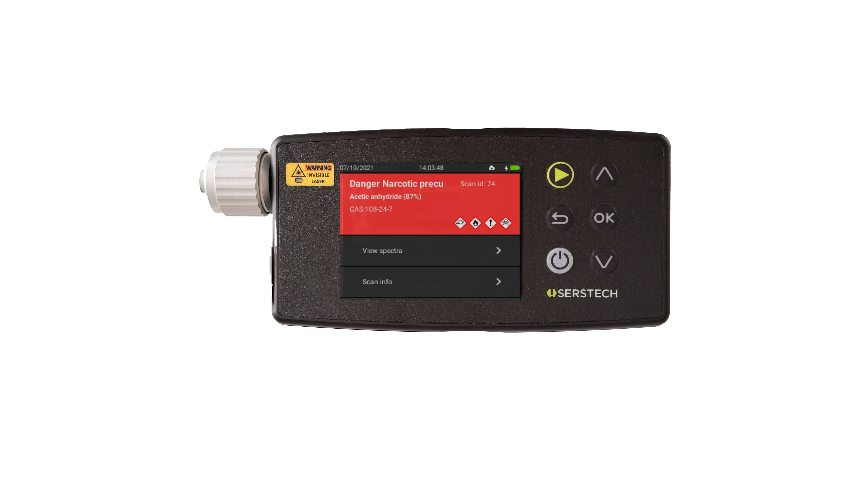
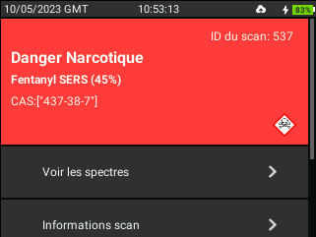
The Technology
A laser adds
energy to the
sample
The vibrational pattern is sent back to the device
The spectrum is matched against reference libraries
The molecules start to vibrate
The device reads the unique spectrum of the sample

Slide 6
Small enough to
fit in your pocket
big enough to
redefine Raman

Slide 7
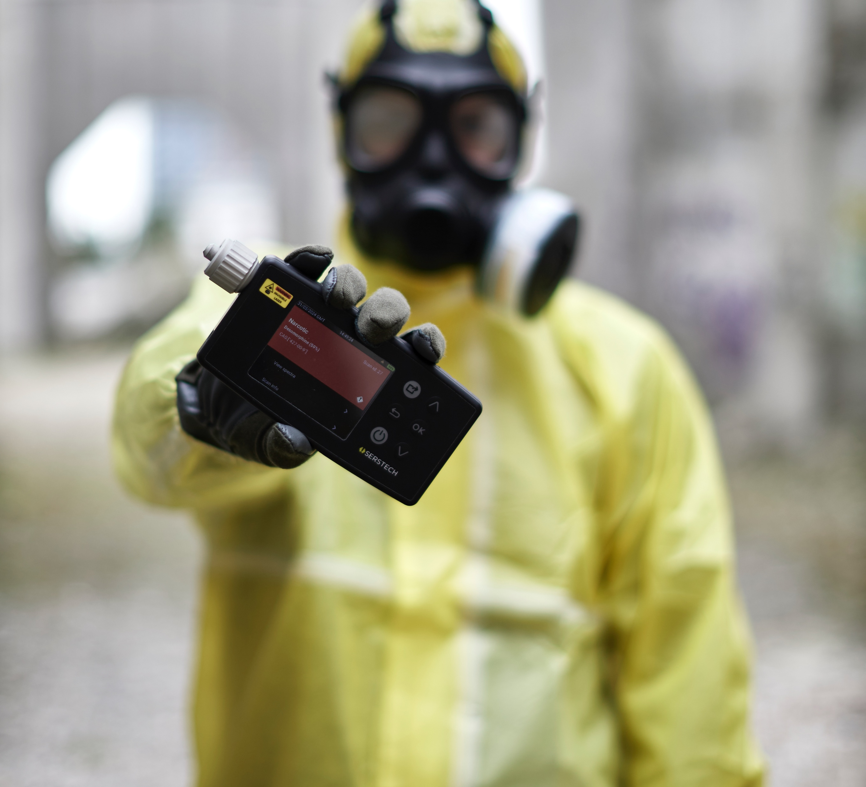
The Product(s)
Serstech Arx mkII
Reference Libraries
SERS Kit (patented)
ChemDash
ChemDash Mobile

Slide 8
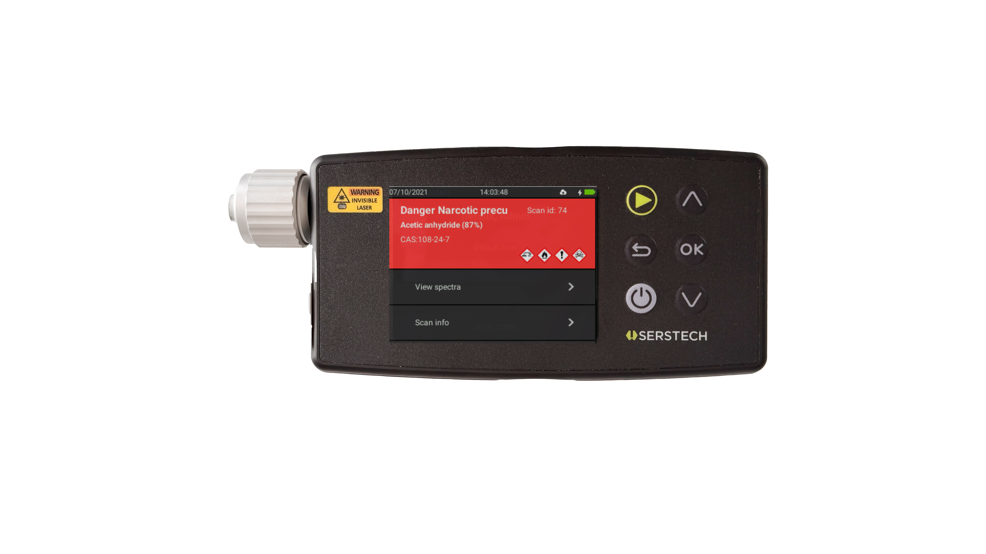
Serstech Arx mkII

Slide 9
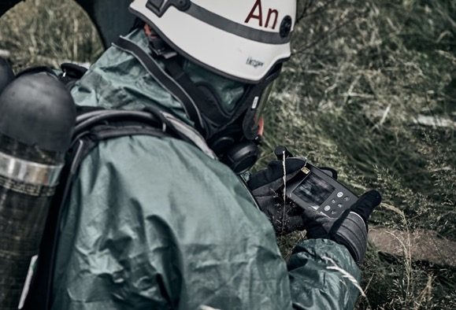
Serstech Arx mkII
Weight only 590g
Fully flexible – selectable libraries
Laser wavelength 785nm
Auto-focus (patented)
Fluorescence reduction
Quick Scan™ (One-hand, single-button operation)
IP67, CE, MIL-STD-810G, 21 CFR Part 11,
Wi-Fi, Barcode reader
No accessories needed – just point and shoot
12 hours battery time in normal operations

Slide 10
Serstech Arx mkII
Ease of use Extreme usability, developed with and for field operators
Portability / Form factor Designed for field use, one hand operation, single button operation etc.
Battery Life 12h+ normal operational use, with convenient USB-C charging
User Interface with feedback Guidance on how to remedy inconclusive measurements
Complex mixtures & impurities Ability to identify significantly more substances than ever before
Fluorescence Reduction Comparable to, or better than 1064nm with New algorithm, Less fluorescence, more Raman signal
Dark & Explosive materials High quality spectra with low laser power
Biotoxins library As the only handheld Raman device Serstech offers a Biotoxins library
ChemDash Mobile Reports on the fly, remote control instrument with Wi-Fi/Bluetooth, GPS coordinates etc.

Slide 11
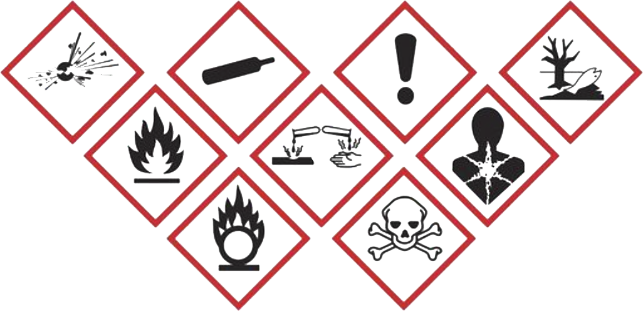
Refence Libraries
17.000+ Substances (24.000 by the end of -24) Narcotics Explosives Hazardous Chemicals Pharmaceuticals Chemical Warfare Agents Bio-Toxins
Validated Spectra GHS Symbols CAS numbers
Updated Quarterly Free of charge for the lifetime of the device

Slide 12
SERS Kit
Quick identification of difficult substances Measure down to PPM level (0,0001%)
Low concentration / fluorescent street samples Heroin, Fentanyl, Meth Amphetamine, Ketamine, Cocaine, Amphetamine, CWA’s etc.
Quick and easy operations in the field
Patented technology
Best in class

Slide 13
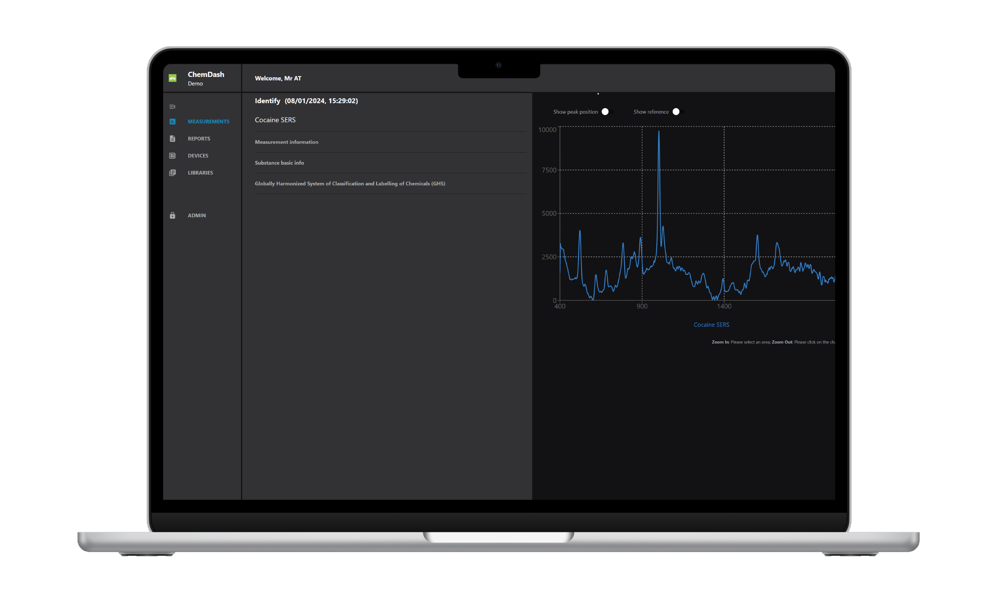
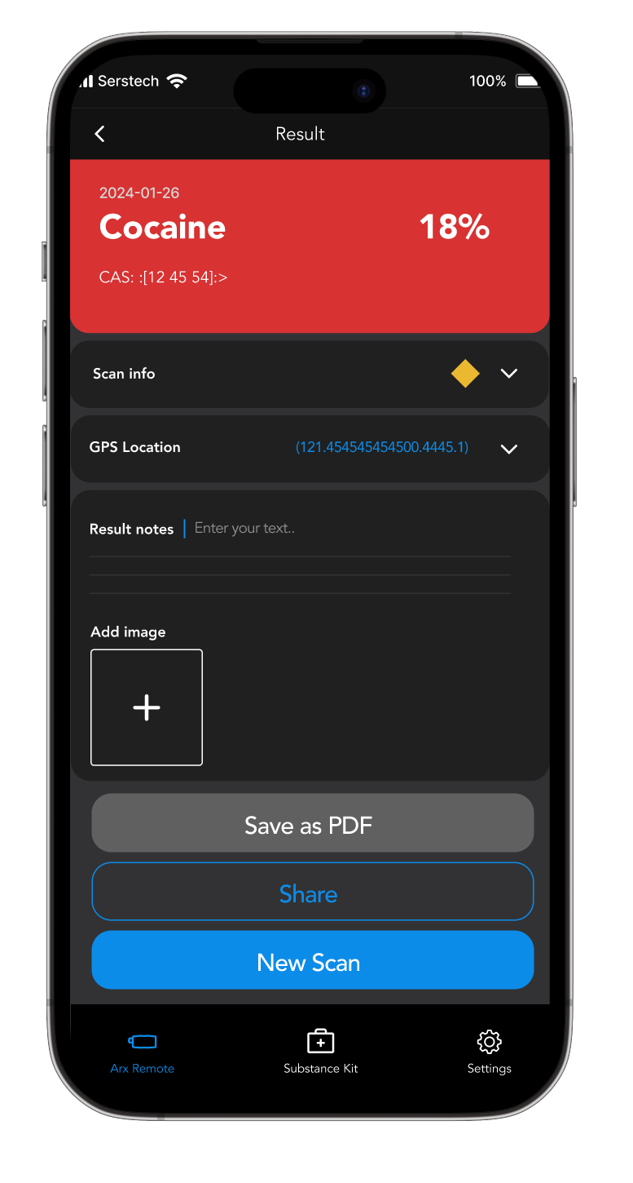
ChemDash & ChemDash Mobile
ChemDash Administrate users, devices, libraries etc. Analyze and compare spectra Export measurments, create and share reports etc.
ChemDash Mobile Generate reports on the fly Remote control Serstech Arx mkII via Wi-Fi or Bluetooth Reach-Back service

Slide 14
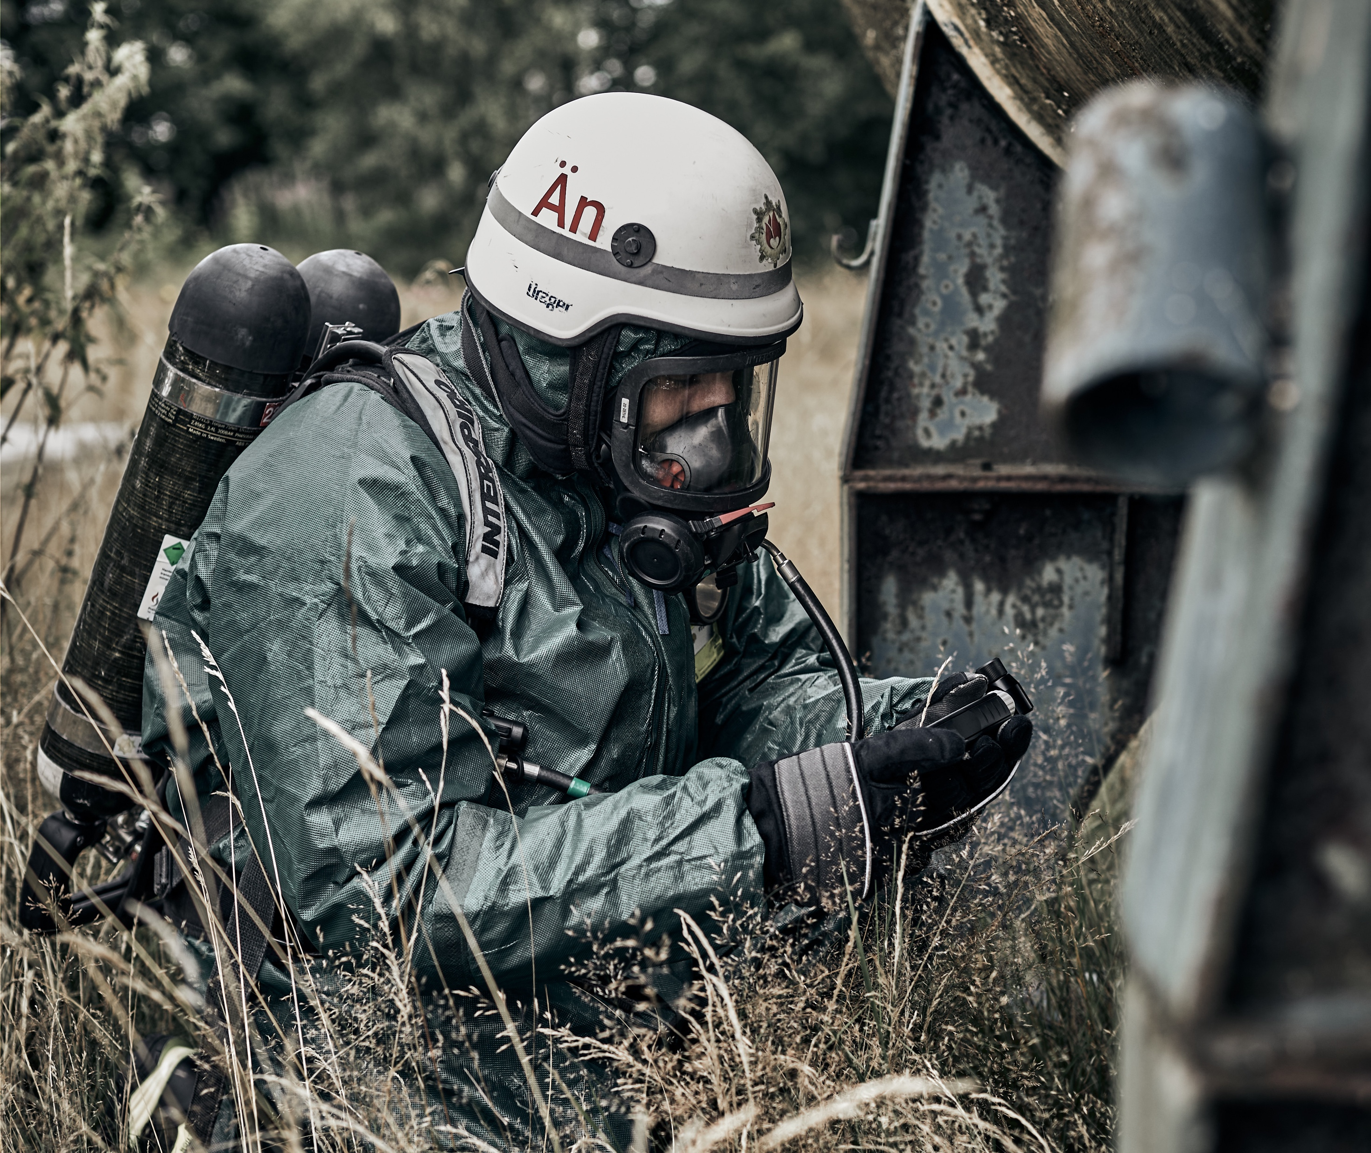
Aftersales
Warranty 5 years warranty – best in the industry
Support Local support through highly skilled partners Serstech dedicated support for trouble shooting and reach-back
Library updates Quarterly updates, free of charge

Slide 15
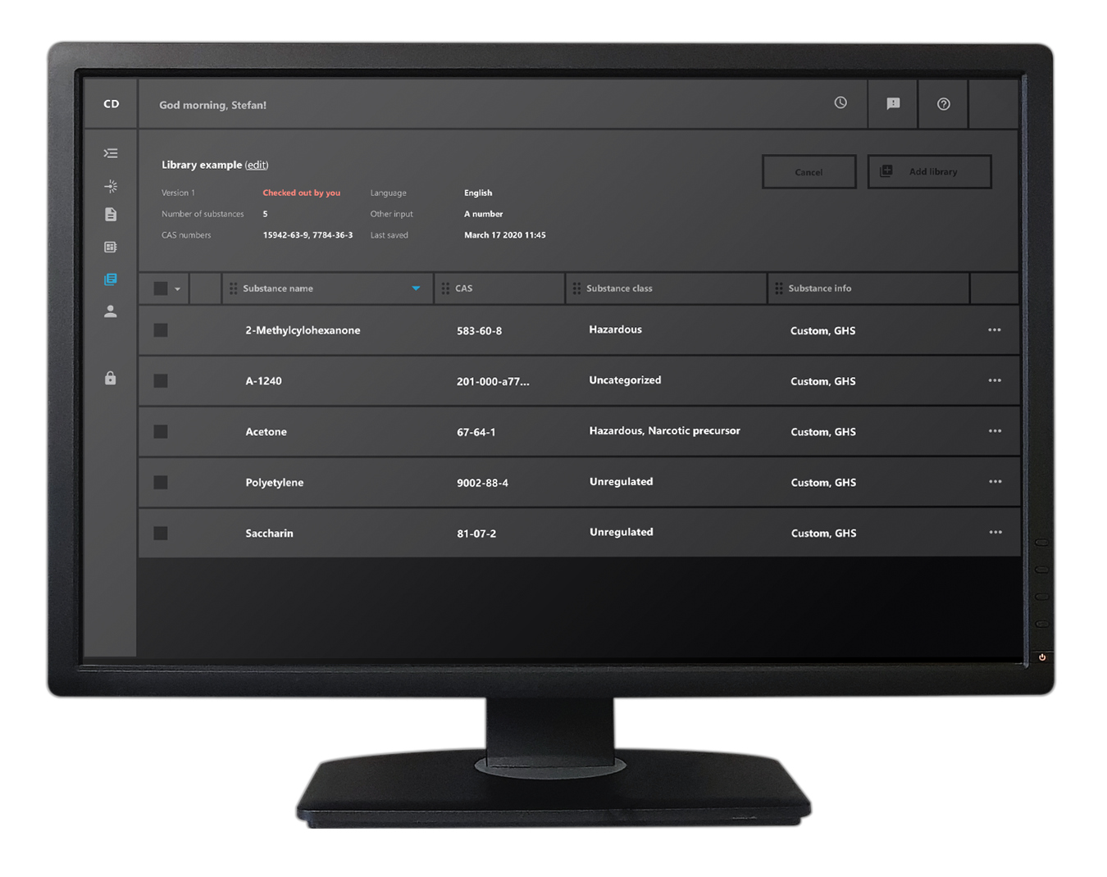
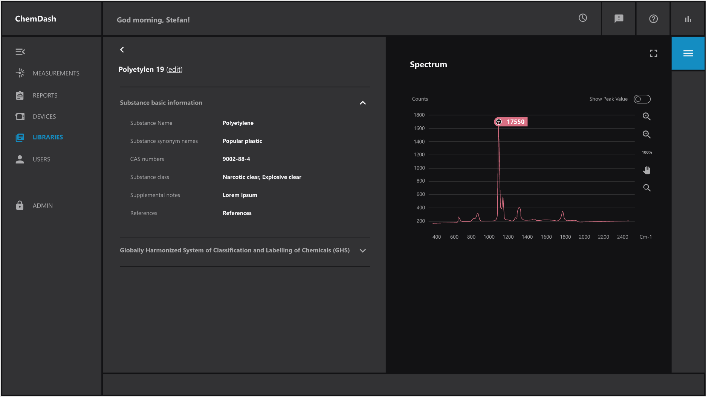
Why Serstech
Made in Sweden
Best in class support
References
Complete solution for chemical threat identification

Slide 16
Thank you
for
listening!
XXXXXXXXX

